Slide 1


http://www.comp.nus.edu.sg/~cs2100/
Recitation-2
Pointers, Functions, Arrays and Structures
L4 and L5 videos
Prabhu NATARAJAN

Slide 2

Notes:
The central teaching of the Bhagavad Gita emphasizes the importance of performing one's duty (dharma) without attachment to the results or outcomes of those actions. This is often expressed as "do your duty without attachment to the fruits of your actions." In other words, one should focus on performing their responsibilities and actions diligently and sincerely, without being overly concerned about the rewards or benefits that may come from those actions.

Slide 3
Agenda
Summary
Weekly Quiz
Extra Exercise
PollEv Quiz

Slide 4
summary
Pointers

Slide 5
1. Pointers (3/3)
You may refer to the address of a variable by using the address operator & (ampersand)
Address.c
int a = 123;
printf("a = %d\n", a);
printf("&a = %p\n", &a);
a = 123
&a = ffbff7dc
%p is used as the format specifier for addresses
Addresses are printed out in hexadecimal (base 16) format
The address of a variable varies from run to run, as the system allocates any free memory to the variable

Slide 6
1.1 Pointer Variable
A variable that contains the address of another variable is called a pointer variable, or simply, a pointer.
Example: a pointer variable a_ptr is shown as a blue box below. It contains the address of variable a.
a_ptr
a
Assuming that variable a is located at address ffbff7dc.
ffbff7dc
123
Variable a_ptr is said to be pointing to variable a.
If the address of a is immaterial, we simply draw an arrow from the blue box to the variable it points to.
a_ptr
a
123

Slide 7
1.4 Accessing Variable Through Pointer
a_ptr
a
123
Once we make a_ptr points to a (as shown above), we can now access a directly as usual, or indirectly through a_ptr by using the indirection operator (also called dereferencing operator) *
printf("a = %d\n", *a_ptr);
≡
printf("a = %d\n", a);
*a_ptr = 456;
≡
a = 456;
Hence, *a_ptr is synonymous with a

Slide 8
summary
Pointer Arithmetic

Slide 9
1.8 Incrementing a Pointer
If p is a pointer variable, what does p = p + 1 (or p++) mean?
Recall Lect#2a slide 16:
int takes up 4 bytes
float takes up 4 bytes
char takes up 1 byte
double takes up 8 bytes
int a; float b; char c; double d;
int *ap; float *bp;
char *cp; double *dp;
ap = &a; bp = &b; cp = &c; dp = &d;
printf("%p %p %p %p\n", ap, bp, cp, dp);
ap++; bp++; cp++; dp++;
printf("%p %p %p %p\n", ap, bp, cp, dp);
ap += 3;
printf("%p\n", ap);
ffbff0a4 ffbff0a0 ffbff09f ffbff090
+4
+4
+1
+8
ffbff0a8 ffbff0a4 ffbff0a0 ffbff098
+12
ffbff0b4
IncrementPointers.c

Slide 10
summary
Pass By Value vs Pass By Pointer

Slide 11
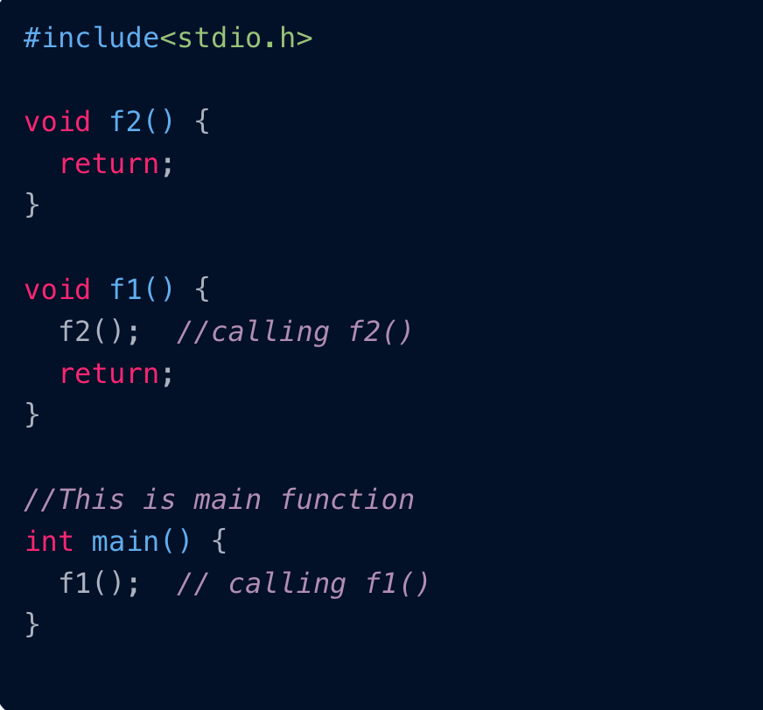
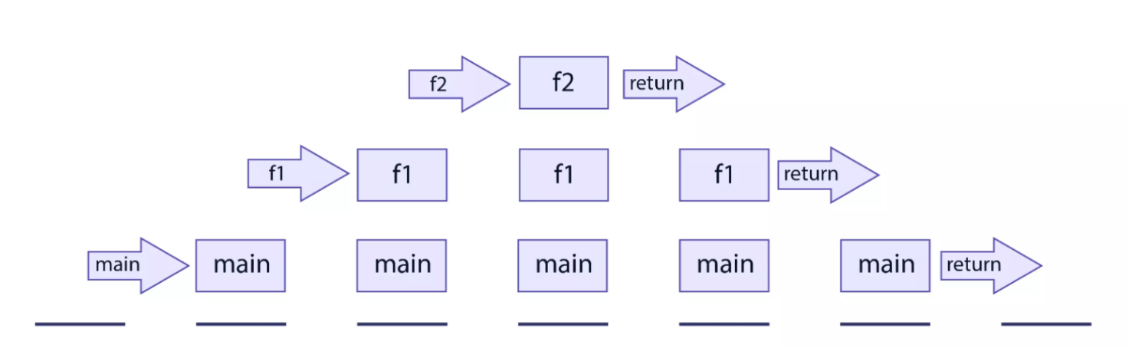
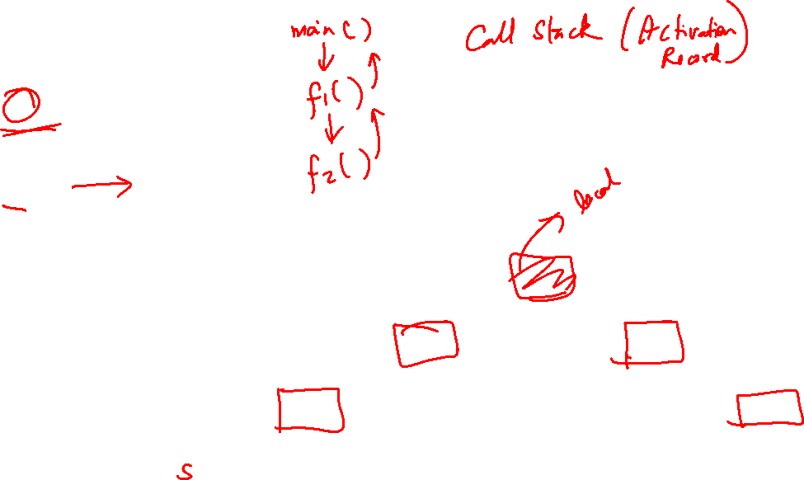
L5 –

Slide 12
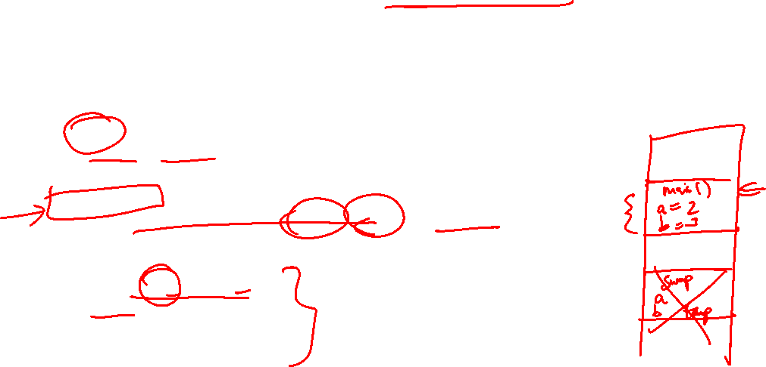
4.1 Consequence of Pass-by-Value
Can this code be used to swap the values in a and b?
In main, before: a=2, b=3
#include <stdio.h>
void swap(int, int);
int main(void) {
int a = 2, b = 3;
printf("In main, before: a=%d, b=%d\n", a, b);
swap(a, b);
printf("In main, after : a=%d, b=%d\n", a, b); return 0;
}
void swap(int a, int b) {
int temp = a;
a = b;
b = temp;
}
In main, after : a=2, b=3
No
SwapIncorrect.c
❖

Slide 13
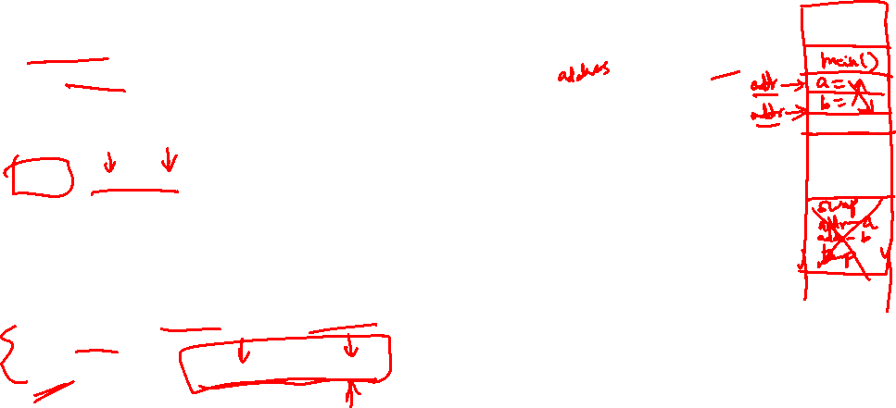
5.1 Function To Swap Two Variables
3
2
#include <stdio.h>
void swap(int *, int *);
int main(void) {
int a, b;
printf("Enter two integers: ");
scanf("%d %d", &var1, &var2);
swap( &a, &b );
printf("var1 = %d; var2 = %d\n", var1, var2);
return 0;
}
void swap(int *ptr1, int *ptr2) {
int temp;
temp = *ptr1; *ptr1 = *ptr2; *ptr2 = temp;
}
In main():
a
2
b
3
In swap():
ptr1
ptr2
SwapCorrect.c

Slide 14
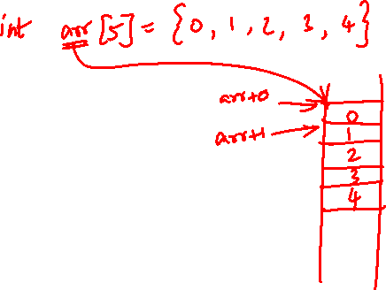
summary
Arrays and Pointers

Slide 15
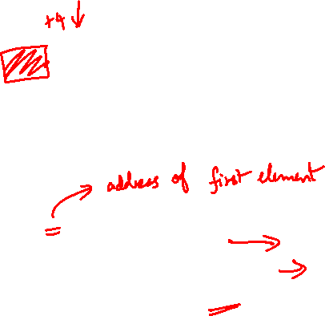
2.2 Arrays and Pointers
Example: int a[10]
a[0]
a[1]
a[2]
a[3]
a[4]
a[5]
a[6]
a[7]
a[8]
a[9]
When the array name a appears in an expression, it refers to the address of the first element (i.e. &a[0]) of that array.
int a[3];
printf("%p\n", a);
printf("%p\n", &a[0]);
printf("%p\n", &a[1]);
These 2 outputs will always be the same.
ffbff724
ffbff724
ffbff728
Output varies from one run to another. Each element is of int type, hence takes up 4 bytes (32 bits).

Slide 16
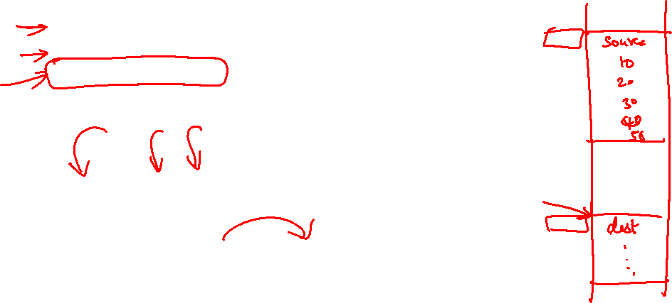
2.3 Array Assignment (1/2)
The following is illegal in C:
ArrayAssignment.c
#define N 10
int source[N] = { 10, 20, 30, 40, 50 };
int dest[N];
dest = source; // illegal!
source[0]
source[9]
10
20
30
40
50
0
0
0
0
0
dest[0]
dest[9]
?
?
?
?
?
?
?
?
?
?
Reason:
An array name is a fixed (constant) pointer; it points to the first element of the array, and this cannot be altered.
The code above attempts to alter dest to make it point elsewhere.

Slide 17
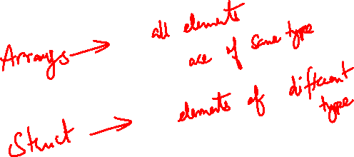
summary
Structures

Slide 18
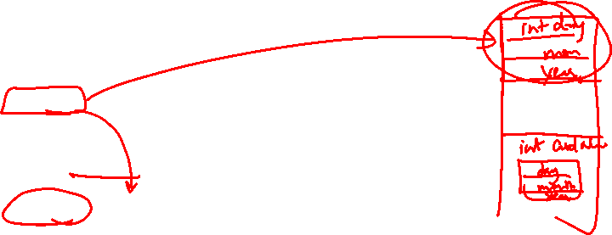
4.3 Initializing Structure Variables
The syntax is like array initialization
Examples:
typedef struct {
int day, month, year;
} date_t;
typedef struct {
int cardNum;
date_t expiryDate;
} card_t;
card_t card1 = {888888, {31, 12, 2020}};
typedef struct {
int stuNum;
float score;
char grade;
} result_t;
result_t result1 = { 123321, 93.5, 'A' };

Slide 19
Quiz Questions

Slide 20
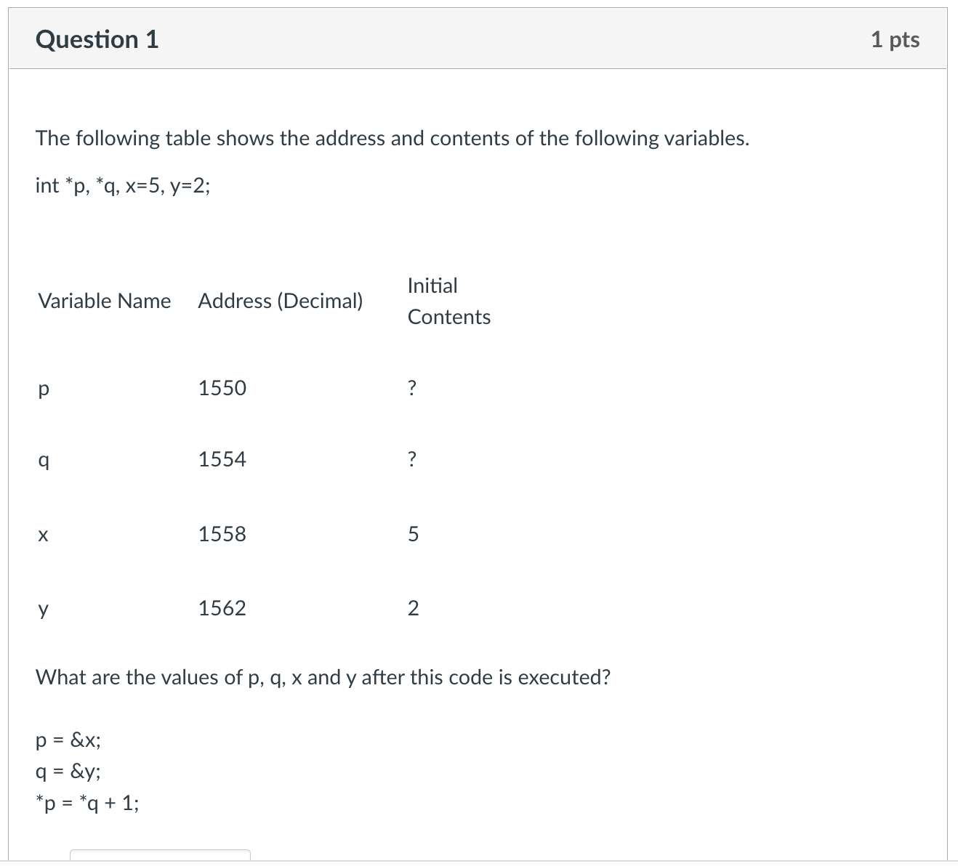
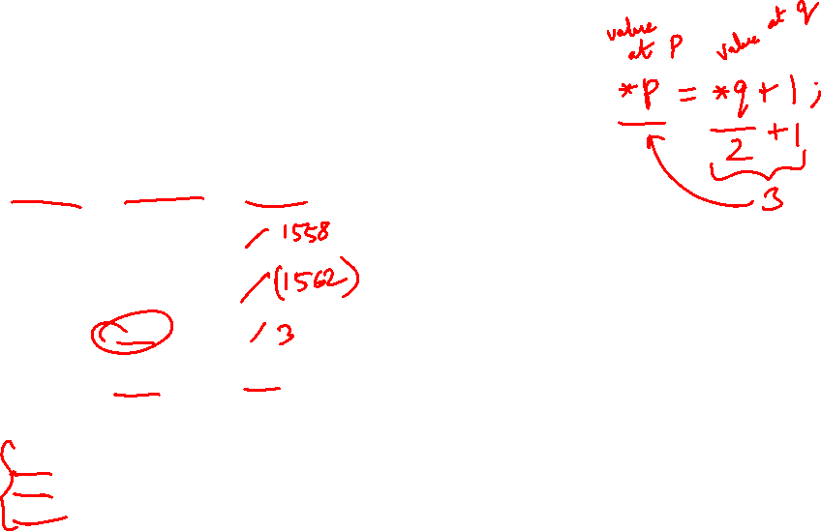
Pointers and Functions Quiz 1

Slide 21
Pointers and Functions Quiz 1
p
q
5
3
2
x
y

Slide 22
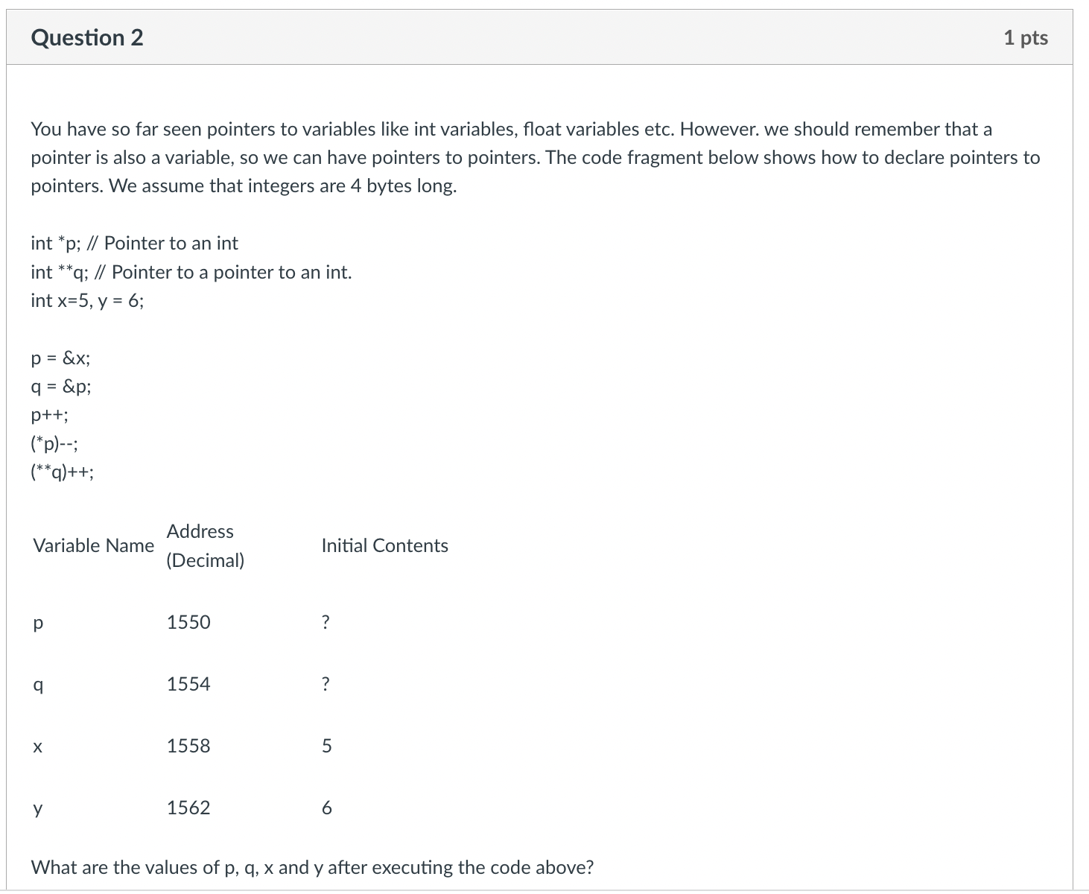
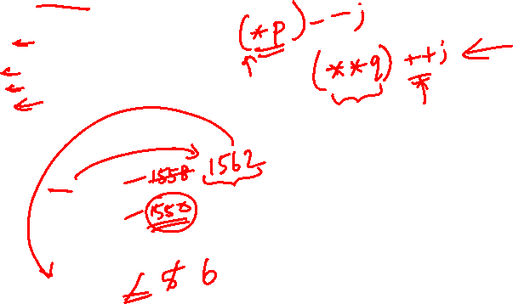
Pointers and Functions Quiz 1

Slide 23
Pointers and Functions Quiz 1
p
q
6
5
5
6
x
y

Slide 24
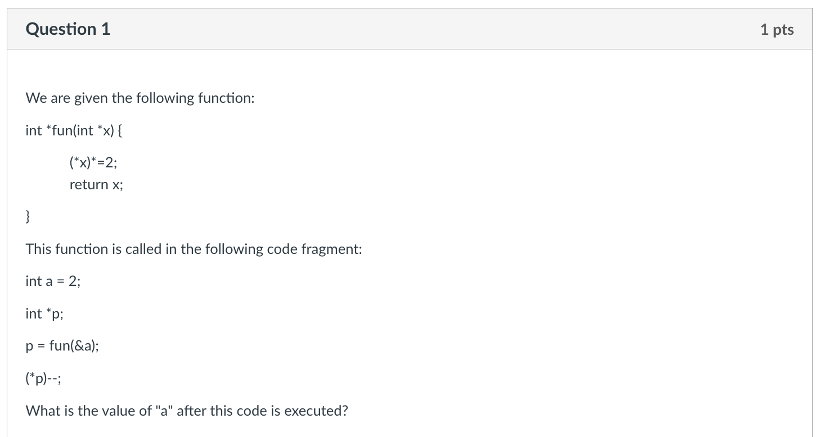
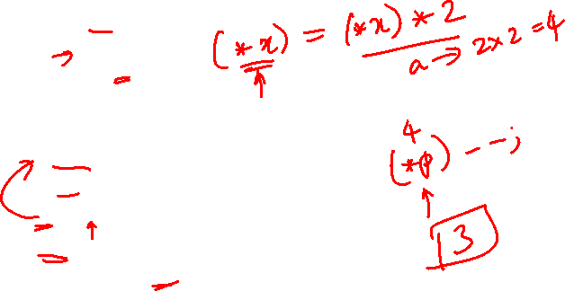
Pointers and Functions Quiz 2

Slide 25
Pointers and Functions Quiz 2
a
p
2
4
3
x

Slide 26
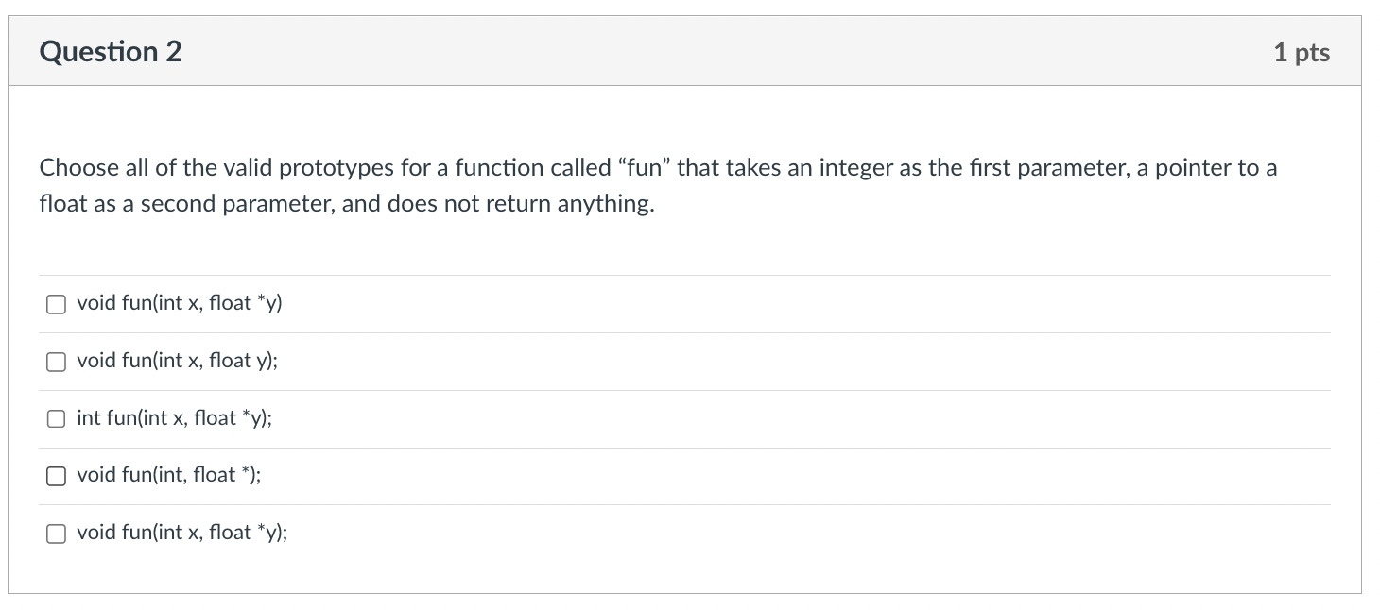
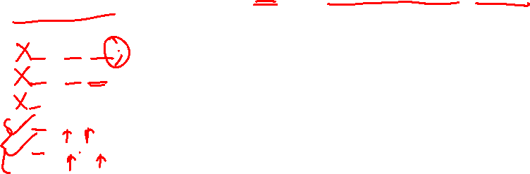
Pointers and Functions Quiz 2

Slide 27
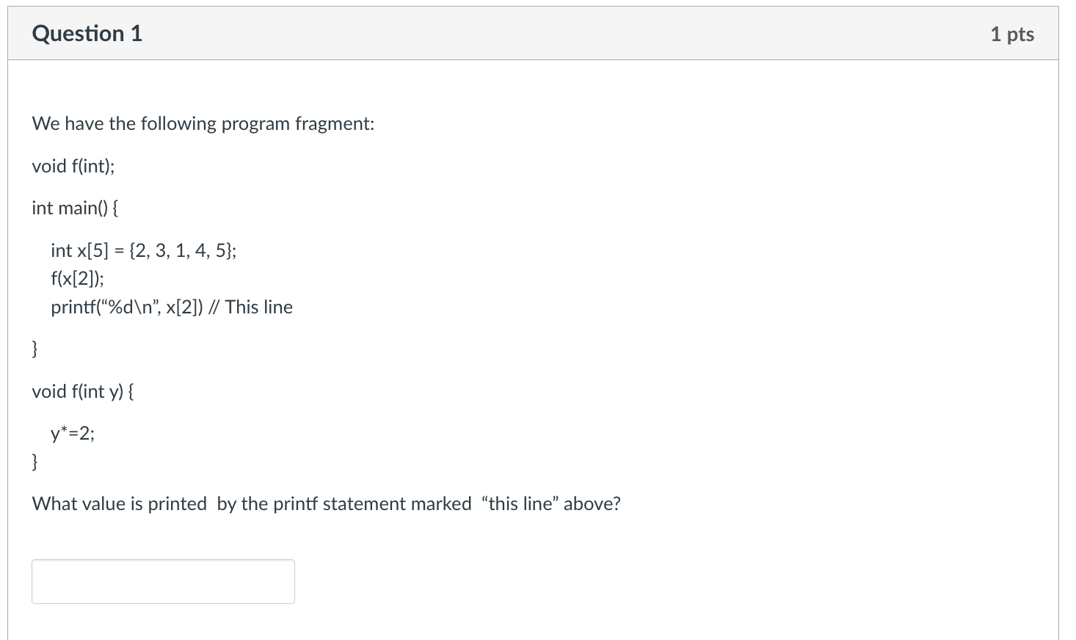
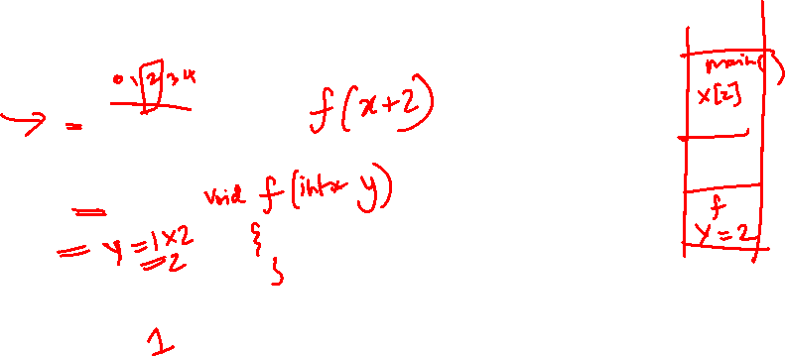
Arrays, Strings and Structures Quiz 1

Slide 28
Arrays, Strings and Structures Quiz 1
X[0]
X[1]
X[2]
X[3]
X[4]
2
3
1
4
5
1
2
y

Slide 29
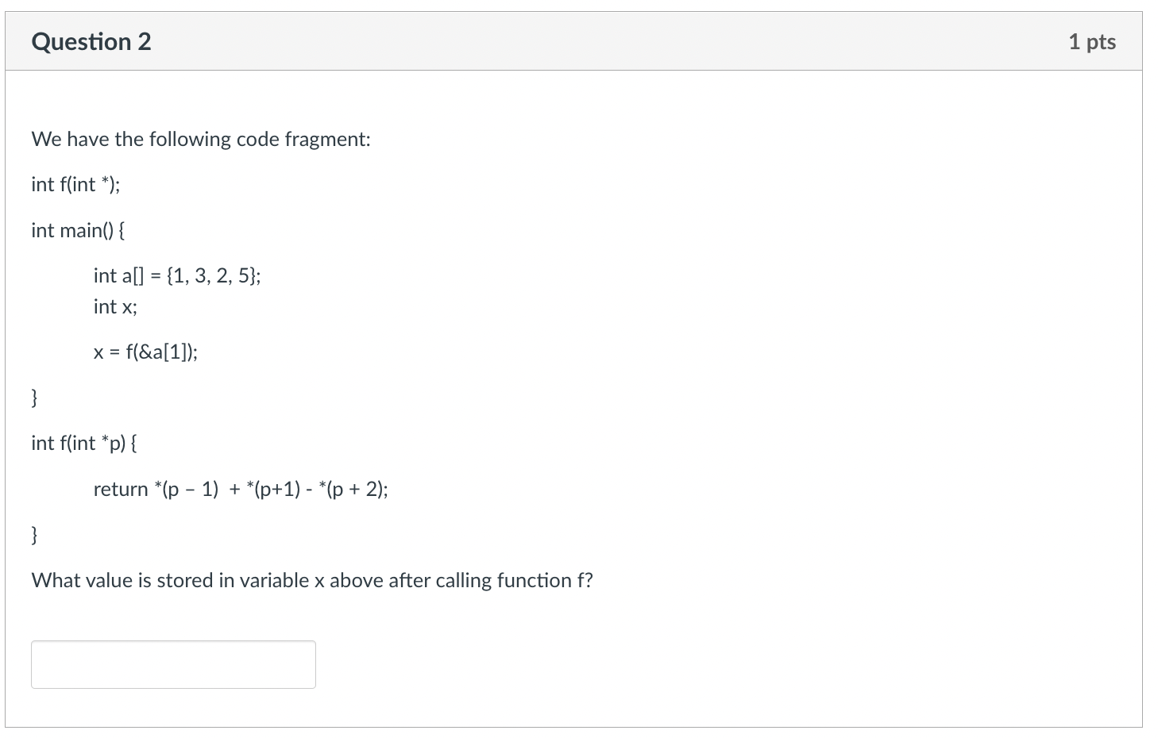
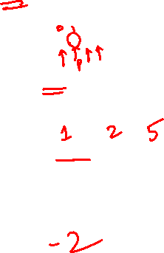
Arrays, Strings and Structures Quiz 1

Slide 30
Arrays, Strings and Structures Quiz 1

Slide 31
Arrays, Strings and Structures Quiz 1
a[0]
a[1]
a[2]
a[3]
1
3
2
5
p
*(p - 1) = 1
*(p + 1) = 2
*(p + 2) = 5
*(p – 1) + *(p + 1) - *(p + 2)
1 + 2 – 5 = -2

Slide 32
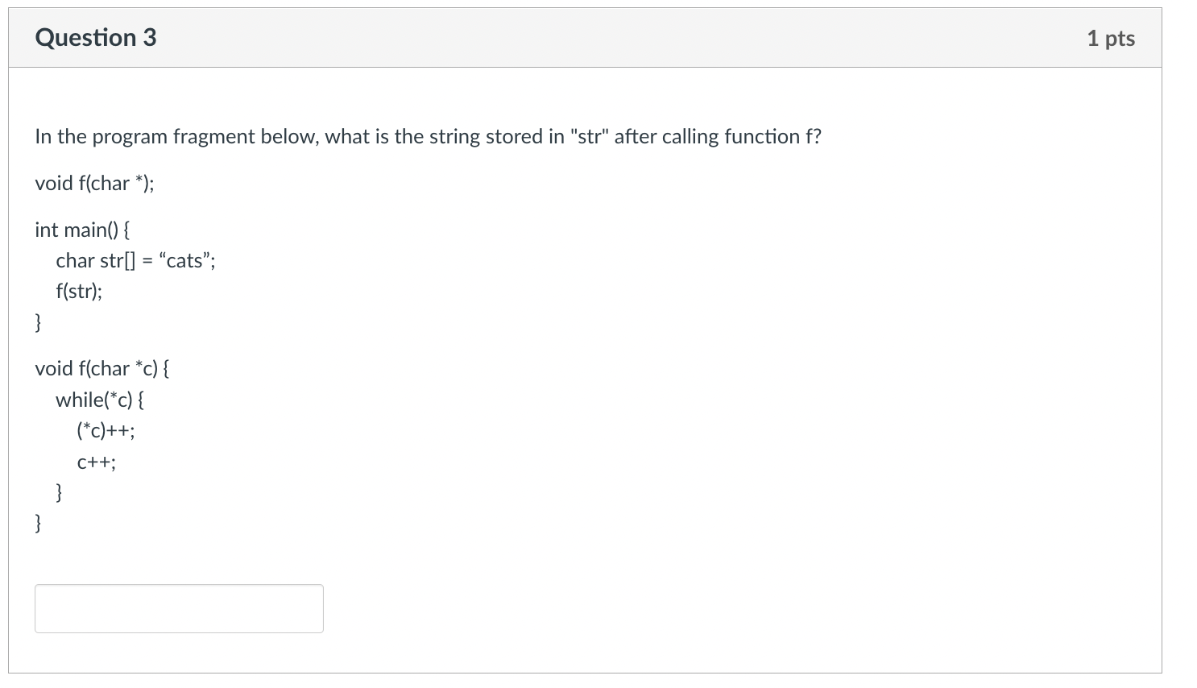
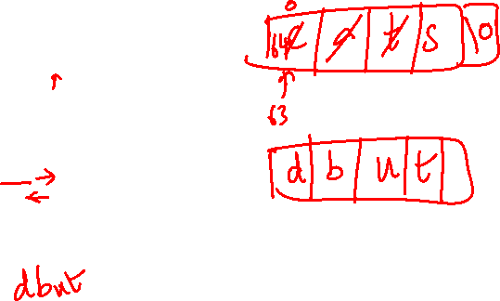
Arrays, Strings and Structures Quiz 1

Slide 33
Arrays, Strings and Structures Quiz 1
str[0]
str[1]
str[2]
str[3]
str[4]
c
d
b
a
t
u
s
t
\0
c

Slide 34
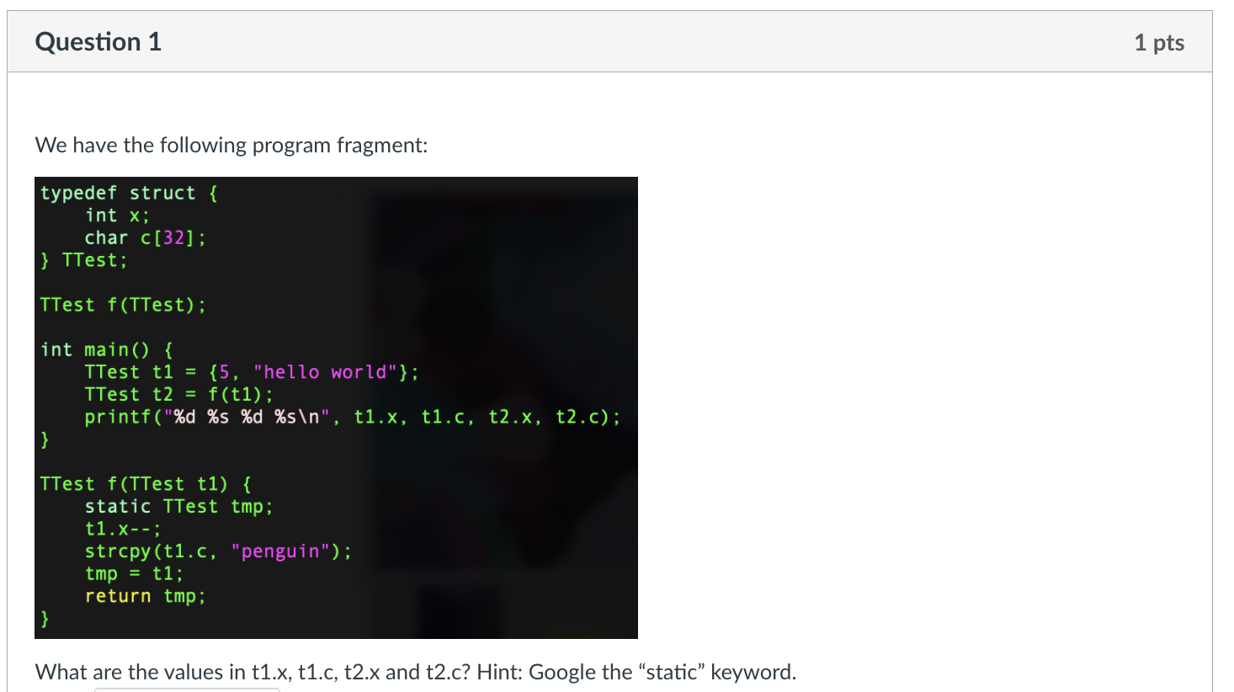
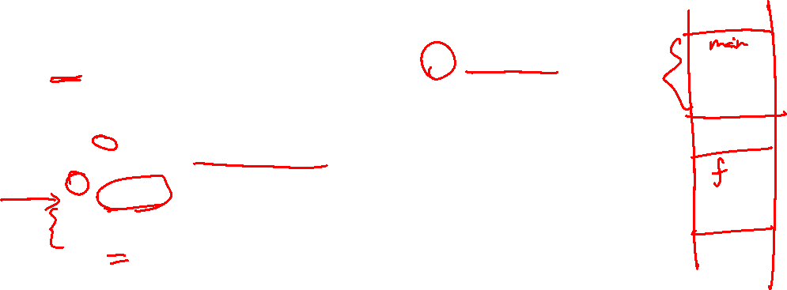
Arrays, Strings and Structures Quiz 2
x
c
t1
5
hello world
x
c
t1
4
5
penguin
hello world
x
c
tmp
4
penguin
x
c
t2
4
penguin
t1.x=5, t1.c=“hello world”
t2.x=4, t2.c=“penguin”

Slide 35
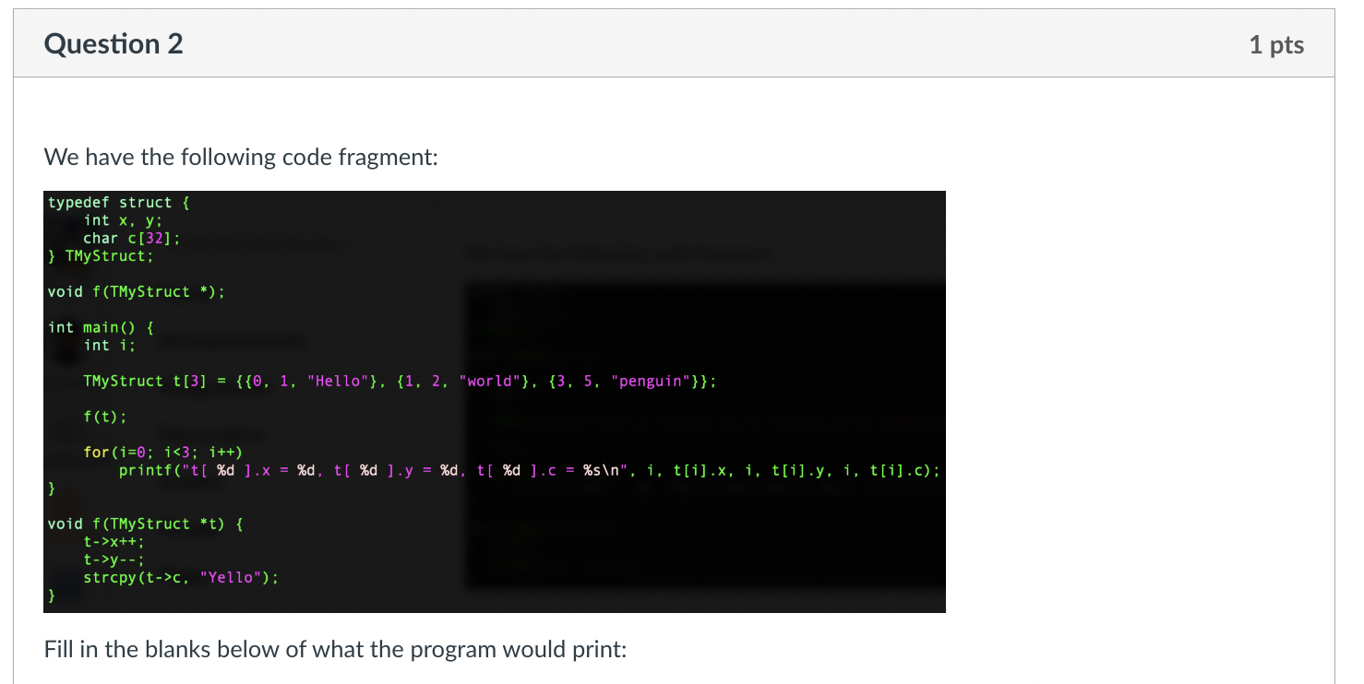
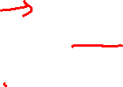
Arrays, Strings and Structures Quiz 2

Slide 36
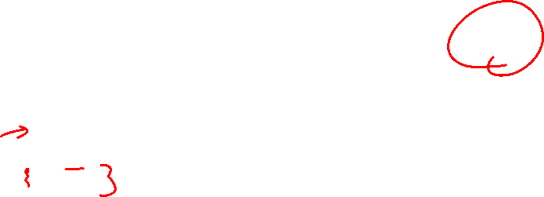
Arrays, Strings and Structures Quiz 2
t[0]
t[1]
t[2]
0, 1, “hello”
1,0, “Yello”
1, 2, “world”
3, 5, “penguin”
t
t[0].x=1, t[0].y=0, t[0].c=“Yello”
t[1].x=1, t[1].y=2, t[1].c=“world”
t[2].x=3, t[2].y=5, t[2].c=“penguin”

Slide 37
Q/A from SeTs

Slide 38
Q/A from SeTs
For the term "side effect" from Lecture 2b, is it the same as those in CS2030 or is it two different things that share the same name?
what is the purpose of pointer variables (a_ptr) ? why cant we just access values by calling on the variable (a) itself?
Is accessing an element of an array equivalent to a dereferencing operation since array names are pointers to the first element of the array?

Slide 39
Q/A from SeTs
typedef struct {
int arr[5];
} tt;
tt a = {{1}}, b;
b = a; // works
b.arr = a.arr; // error
Could you explain why b=a works although array can not be reassigned? (What's the detailed process for b=a, in terms of memory?)

Slide 40
Extra Exercises

Slide 41
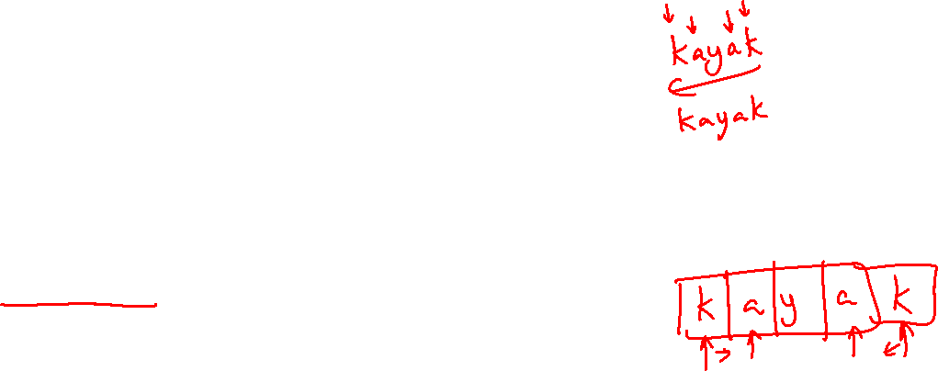
Extra Exercises Exercise 1 – Palindrome Checker 1
A palindrome is a series of characters that reads the same way from left to right and right to left.
Examples: level, rotor, kayak, Able was I I saw Elba
Notice that capitalization does not matter.
Write a palindrome checker in C that:
Reads in a string from the user (may contain spaces and mixed capitalization)
Prints “YES it is a palindrome” if the input string is a palindrome, or “NO it is not a palindrome” otherwise.
Use array indexes to solve this problem.

Slide 42
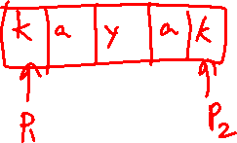
Extra Exercises Exercise 2 – Palindrome Checker 2
Solve Exercise 1 using only pointers and pointer arithmetic.

Slide 43
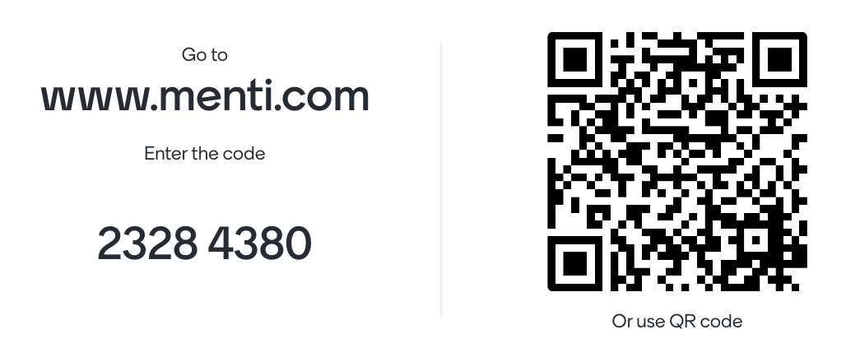
Mentimeter Quiz

Slide 44
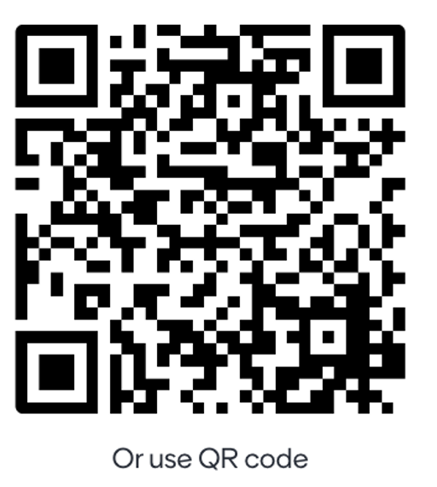
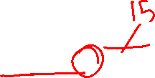
Q1
Consider the following C code:
void modify(int x, int *y) {
x = x + 10;
*y = *y + 10;
} int main() {
int a = 5; int b = 5;
modify(a, &b);
printf("a = %d, b = %d\n", a, b);
return 0;
}
What will be the output of the printf statement in the main function?
A) a = 15, b = 15 B) a = 5, b = 15 C) a = 15, b = 5 D) a = 5, b = 5

Slide 45
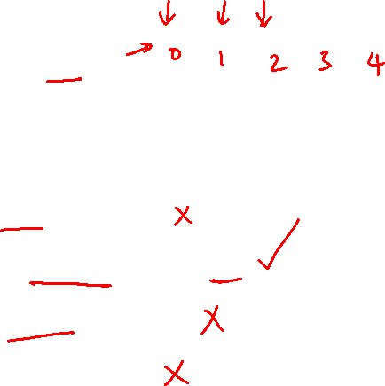
Q2
Consider the following C code snippet:
int arr[] = {10, 20, 30, 40, 50};
int *ptr = arr;
Which of the following statements is true regarding the pointer ptr after executing this code?
Options:
A) *ptr will print 20.
B) *(ptr + 2) will print 30.
C) ptr[4] will print 40.
D) All of the above.

Slide 46
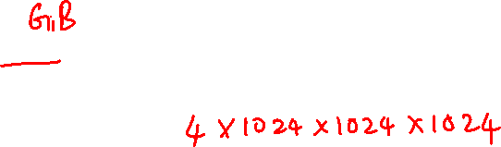
Q3
If a computer has 4 GB of memory and each byte of memory has a unique address, how many unique memory addresses are there in total?
A) 4,000
B) 4,000,000
C) 4,294,967,296
D) 4,096

Slide 47
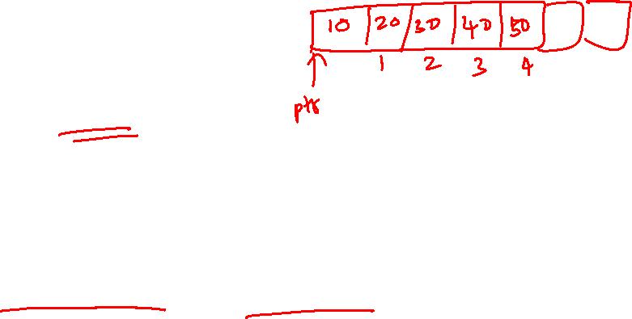
Q4
Consider the following C code snippet:
int main() {
int arr[5] = {10, 20, 30, 40, 50};
int *ptr = arr;
printf("%d\n", *(ptr + 6));
return 0;
}
What is the most likely outcome of running this code?
A) It will print the value 50. B) It will print the value 0, as default uninitialized values are 0. C) It will produce a segmentation fault or other runtime error due to accessing memory outside the bounds of the array. D) It will print the value stored at arr[0] because out-of-bounds accesses wrap around to the start of the array.

Slide 48
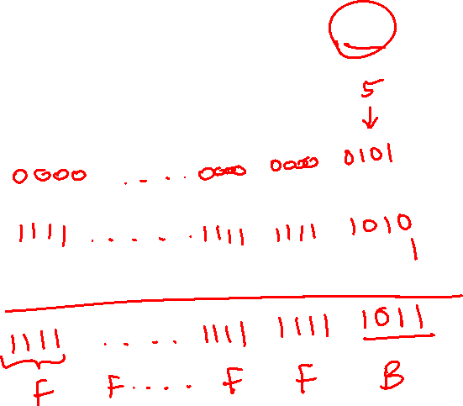
Q5
In a 32-bit system using 2's complement notation, how is the value -5 represented in memory? Select the correct hexadecimal representation:
Options:
A) 0xFFFFFFF5
B) 0x000000FB
C) 0x00000005
D) 0xFFFFFFFB
Notes:
How 2's Complement Works for -5:
Positive 5 in Binary: 0000 0000 0000 0000 0000 0000 0000 0101
Invert the Digits: 1111 1111 1111 1111 1111 1111 1111 1010
Add One to the Inverted Binary: 1111 1111 1111 1111 1111 1111 1111 1011
Hexadecimal Representation: This is 0xFFFFFFFB.

Slide 49
End of File

